Slide 1
STEP BUSINESS PRESENTATION
Luke Telidetzki
Timotei Albu
Paolo Fajardo
Stephen Arychuk
MIS 418, GROUP 3

Slide 2
Outline of Presentation
Analysis
Overview
Prototype
Marketing
Summary

Slide 3

Business Idea
Increase efficiency and usability for businesses that utilize STEP in training their employees
Analysis
Overview
Prototype
Marketing
Summary

Slide 4
Business Vision
Streamline
Simplify
Remove unnecessary steps and procedures by moving majority of business to an online medium wherever possible.
Ensure that clients and customers can navigate the website as easily and simply as possible.
Analysis
Overview
Prototype
Marketing
Summary

Slide 5
Recommendation
Move e-courses and products to be available online
Streamline registration/payment to be completed online for in person workshops, courses, e-courses, and products
Allow customers to view and write reviews for all courses, products, and workshops
Analysis
Overview
Prototype
Marketing
Summary

Slide 6
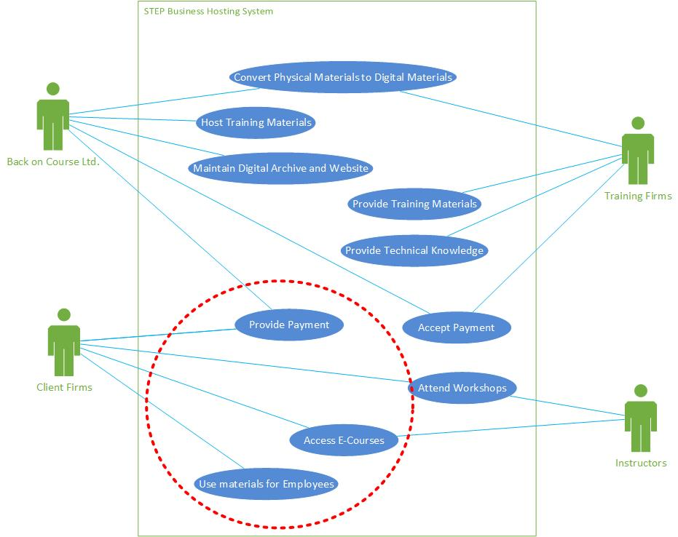
Use Case
Digitizing STEP
Focus on E-commerce features - Website development for client interaction
Sell and Deliver Products through the Internet
Sell and Deliver In-person Workshops through the Internet
Sell and Deliver E-Courses through the Internet
Analysis
Overview
Prototype
Marketing
Summary

Slide 7
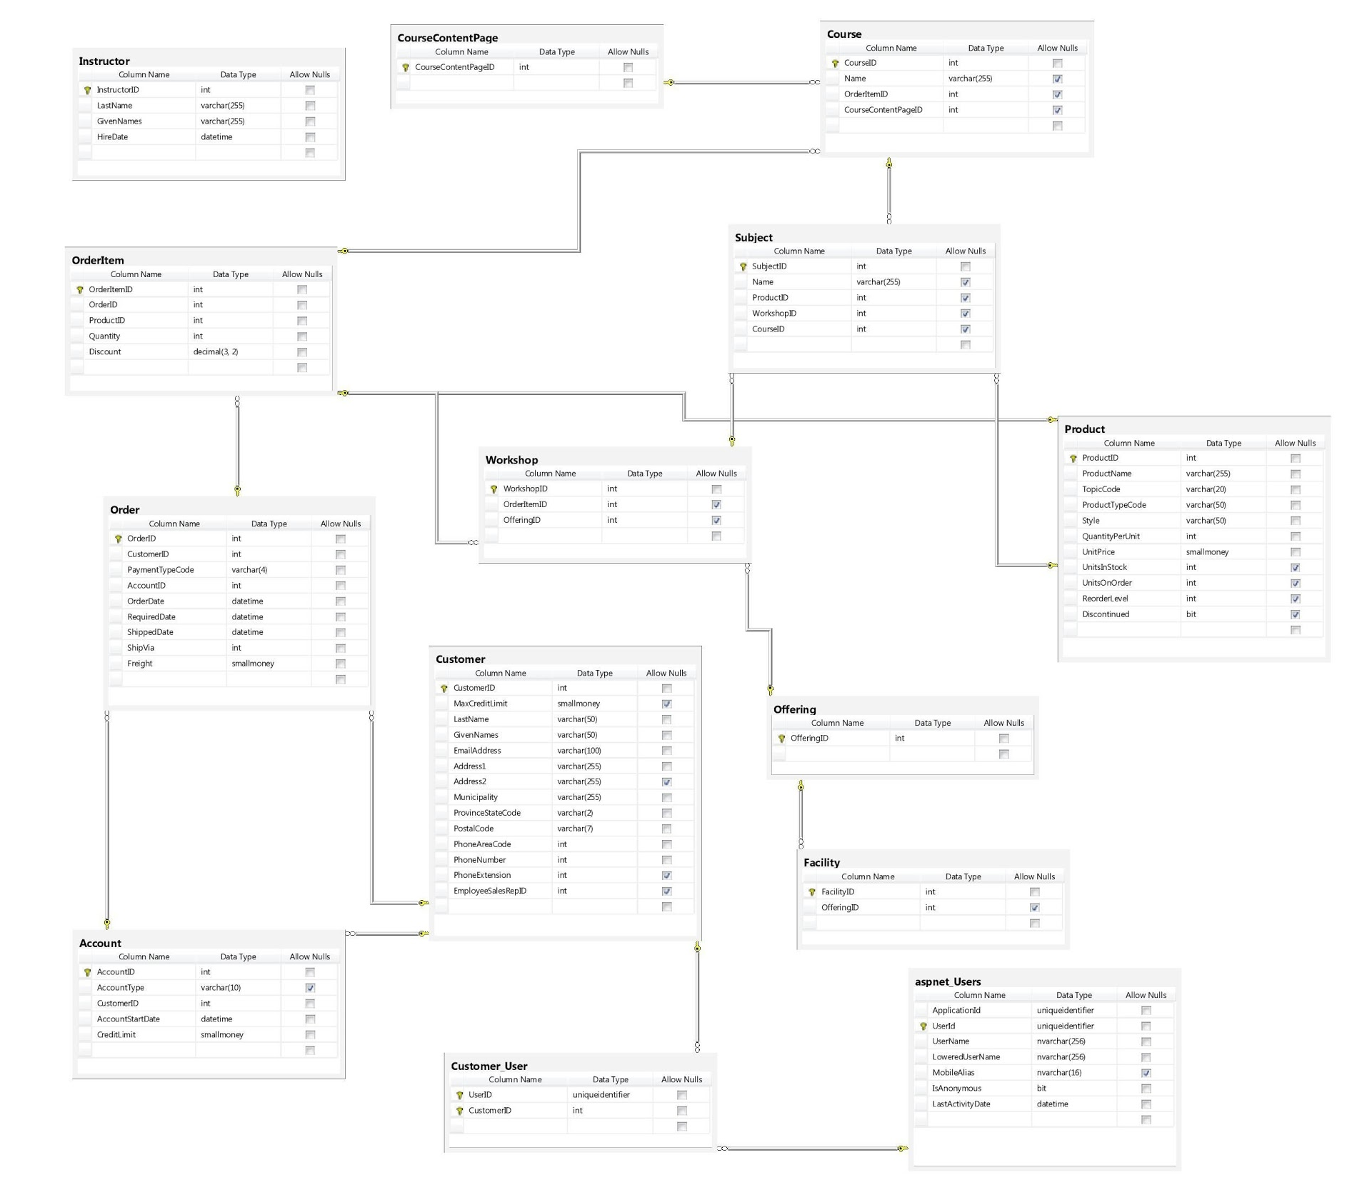
Database Design
Analysis
Overview
Prototype
Marketing
Summary

Slide 8
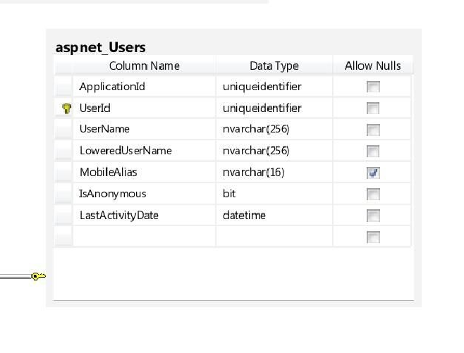
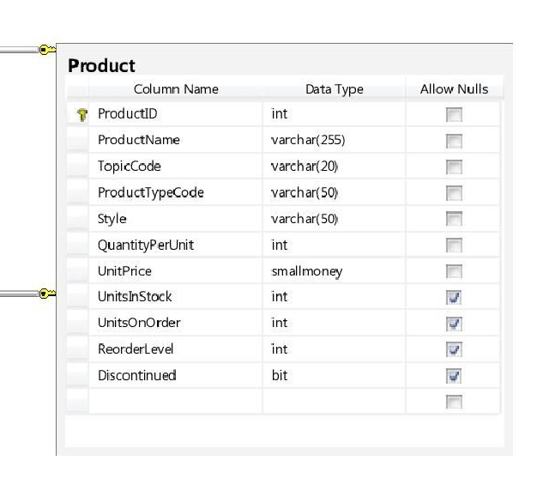
Database Design
Analysis
Overview
Prototype
Marketing
Summary

Slide 9
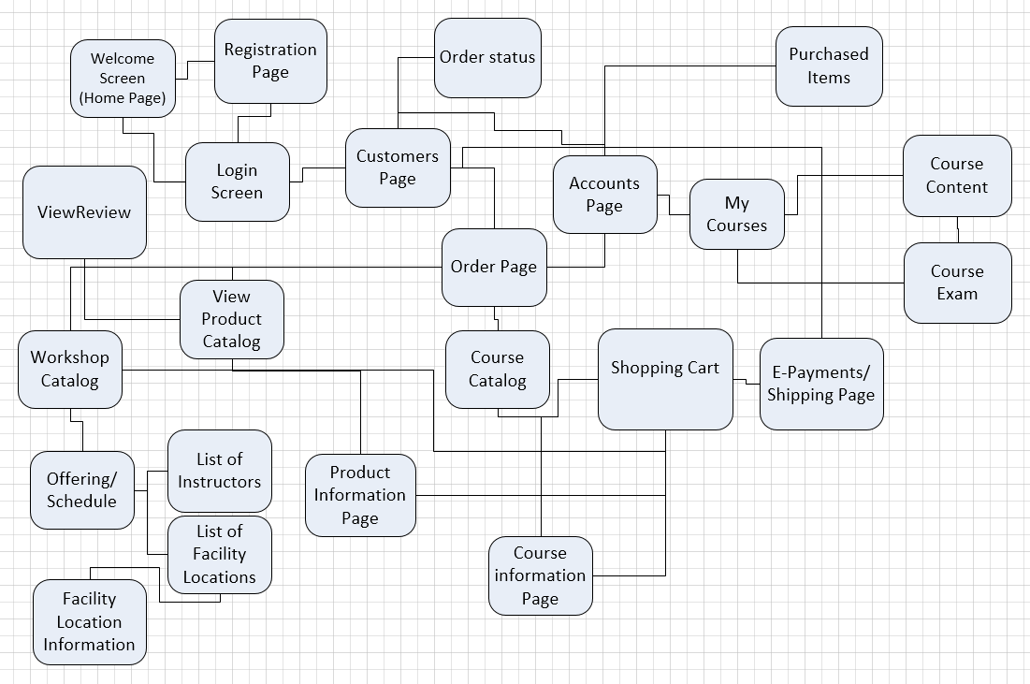
Website Navigation
Customer/ClientWebpages
Payment Webpages
Products/Workshops/Courses Webpages
Analysis
Overview
Prototype
Marketing
Summary

Slide 10
Purchasing A Product
TC ID# | Scenario/Condition | Login | View Purchase Catalog | Add to Shopping Cart | Payment | Expected Result
CW1. | Scenario 1 - Successful Product Purchase | V | V | V | V | Successful Product Purchase
CW2. | Scenario 2 - Login Page - Incorrect Credentials | I | V | V | V | Message - Invalid Credentials - Return to Login Page
CW3. | Scenario 3 - Login Page - No Account | I | V | V | V | Message - Register - Direct to Register Page
CW4. | Scenario 4 - Catalog is empty (No Products are available) | V | I | V | V | Message - No Products are currently for sale. Return to Login Page
CW5. | Scenario 5 - Product Out of Stock | V | V | I | V | Warning message - Product out of stock. Return to View Catalog
CW6. | Scenario 6 - Payment cannot be made (Invalid credit card) | V | V | V | I | Warning message - Payment did not go through, use another payment method - return to Payment Page
Analysis
Overview
Prototype
Marketing
Summary

Slide 11
Leaving A Review
TC ID# | Scenario/Condition | Login | View Purchase Catalog | Product Information | Review | Expected Result
CW1. | Scenario 1 - Successful Review | V | V | V | V | Successful Review - Return to View Catalog Page
CW2. | Scenario 2 - Product/Course not available | V | V | I | V | Message - Product not available anymore - Return to View Catalog
CW3. | Scenario 3 - Review is empty | V | V | V | I | Message - Review is empty - return to Review Page
CW4. | Scenario 4 - Review is too short | V | V | V | I | Message - return to Review Page
Analysis
Overview
Prototype
Marketing
Summary

Slide 12
Prototype
Analysis
Overview
Prototype
Marketing
Summary

Slide 13
Usability Report
Summary:
Report tested Purchasing a Product and Leaving a Review Processes
Tester satisfied with Usability report
Tester Positive Comments:
Accessibility is adequate – able to navigate webpages with ease
Account management
Freedom
Improvement Areas
Visual interface can be improved
Features not yet fully implemented
Analysis
Overview
Prototype
Marketing
Summary

Slide 14

Advertising Campaign
Business Magazines
Business Conferences
Online Advertisements
Analysis
Overview
Prototype
Marketing
Summary

Slide 15


Advertising Campaign
Business Magazines
Analysis
Overview
Prototype
Marketing
Summary

Slide 16
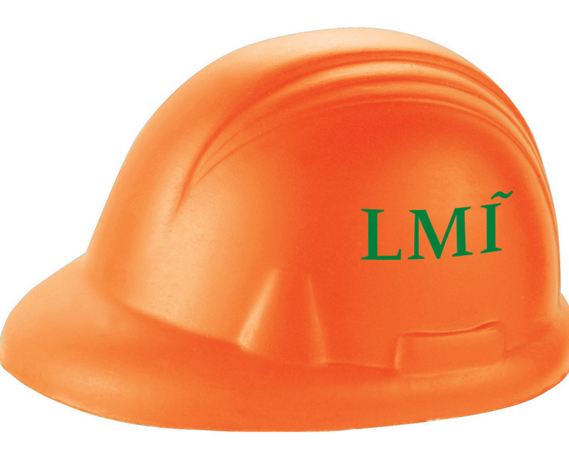

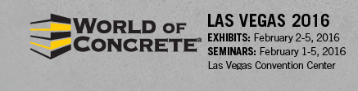

Advertising Campaign
Business Conferences
Analysis
Overview
Prototype
Marketing
Summary

Slide 17
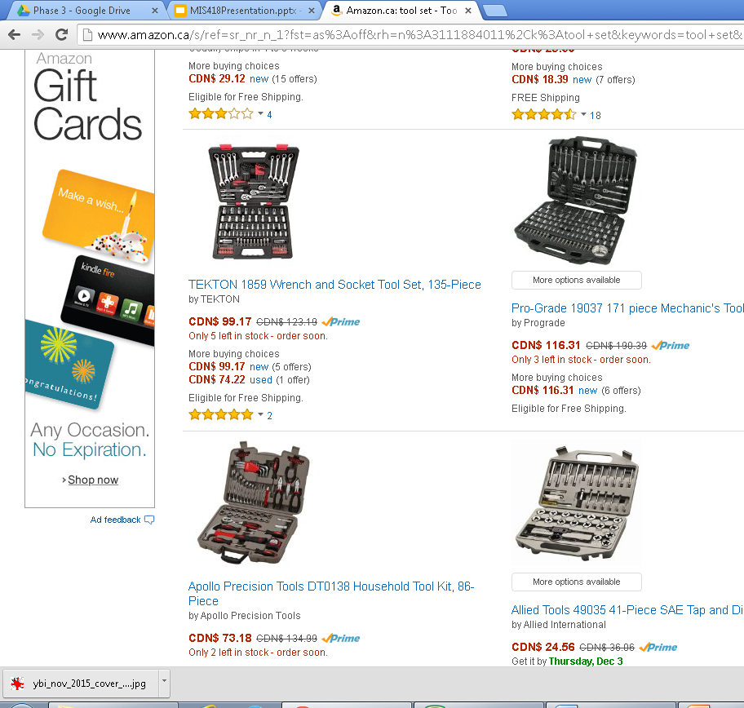
Advertising Campaign
Online Advertisements
STEP advertisement here
Analysis
Overview
Prototype
Marketing
Summary

Slide 18
Summary
Business Idea/Vision
Simplified
Streamlined
Easy to use
Convenient to the client
Prototype
Marketing
Business Magazines
Business Conferences
Online Advertising
Analysis
Overview
Prototype
Marketing
Summary

Slide 19
Questions

